Slide 1
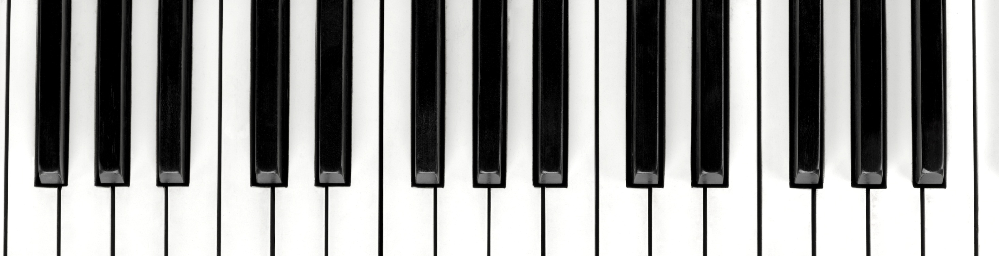
Music Classifier – Singer Identifier
G1-MusicDeciphers
- Likhil Kumar
- Nandakishor Pulagam
- Nirupam Kumar
- Soujanya Navuluru
- Vuthej Krishna

Slide 2
Agenda
Motivation & Introduction
Goals
Data Sources
Data Acquisition
Pre-Processing
Feature Extraction
Overview of Attributes available
Univariate analysis on attributes
Outlier analysis
PCA
Correlation
Future work
Challenges faced

Slide 3


Motivation & Introduction
Ever felt the need to discover more about a song after hearing a glimpse of it (may be in a shopping mall or in an airport or public gatherings or restaurants/pubs?)
It certainly is tough to identify a song which we have never heard of before. Especially with the growing number of new songs.
To ease the access of discovering and to eliminate the need to lookup and search for a song, we propose a micro-service that identifies the song, singer within, genre of the song and also provides lyrics of the song.
Identifying the genre will help us to extend the functionality of our micro-service to further incorporate a recommendation system.

Slide 4
Goals
To create a micro-service (API end-point) with below features.
Singer identification
Recognizing the genre
To provide the lyrics of the song
Songs spanning across multiple languages
English
Hindi
Telugu

Slide 5


Data Sources

Slide 6
Data Acquisition - Steps Involved
Jio saavn
Created the playlist manually for individual genre and artists
Consumed Jio-Saavn API to extract data
Install required packages and run the app locally
Get the complete details about playlist by passing it to the app server
Save the responses into json file
Deezer
Creating developer account in Deezer to obtain API host and API key.
Select the playlists of top chosen artists and collect details of artists along with their id’s.
Loop through songs data to extract top 50 songs for each artist using respective artist’s id.
Filter to eliminate bad request data and convert received string into required json format.
Note - Data acquired for Artists and Genre are different without any overlapping. This is because of unavailability of wide range of genres from a single artist.

Slide 7

Pre-processing
Mp3 and Mp4 formats are extracted from Deezer and Jio-Saavan respectively.
Converting all the formats to a single format (.wav) by using R
Spleeter module from python is used to split the song data into vocals and musicals separately.
Each wav file is divided into multiple instances of five second windows to obtain more intrinsic features.

Slide 8
Feature Extraction
WAV File
Librosa
Spectral Features
Tempo
Zero Crossings
Spectral Band Width
Spectral Contrast
Spectral Centroid
Spectral Roll-off
Spectral Flatness
Chroma STFT
Chroma CQT
Chroma CENS
Mel Frequency

Slide 9
Feature Importance
Tempo Rate of musical beats present in the audio.
Zero Crossings Point at which the polarity changes. Used in estimating fundamental frequency of speech.
Spectral Band Width Wavelength interval in which the spectral quantity is not less than half its maximum value. (High and Low Pitch detection)
Spectral Contrast Energy contrast of sub-bands in a spectrogram captures the presence of clear narrow-band signals from broad-band noise.
Spectral Centroid Center of mass of the spectrum can be calculated using this feature. Also used in characterizing a spectrum. (Brightness and Warmth)
Spectral Roll-off Used in approximating maximum & minimum frequency, it is a threshold below which 85% of energy of the spectrum is present.

Slide 10
Feature Importance
Spectral Flatness Measures the presence of noise in audio in contrast to measuring the presence of toned data. High value indicates presence of white-noise.
Chroma Short-Time Fourier Transform Presence of tonal content can be captured as this feature classifies input data into 12 different pitches.
Chroma Constant Q-Transform Provides better resolution for very low and very high frequencies which are often difficult to capture and process.
Chroma Energy Normalized Effectively helps in audio classification, this feature is robust to dynamics, timbre and articulation. This is a variant of chromagram.
Mel Frequency Plays vital role in speech recognition and in identifying singers from the audio input.
Mel Frequency Cepstral is a combination of MFC coefficients.

Slide 11
Overview of Attributes
On aggregation of all the features, total attributes for our dataset are 127 including the target.
Majority of the attributes are numerical i.e. 124 features
‘Song_id’, ‘language’ and ‘target’ are the only categorical attributes
Number of Data Instances for Artists Data – 13116.
Number of Data Instances for Genre Data – 9659.

Slide 12
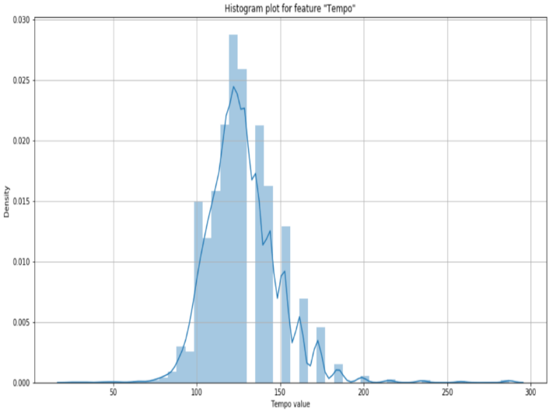
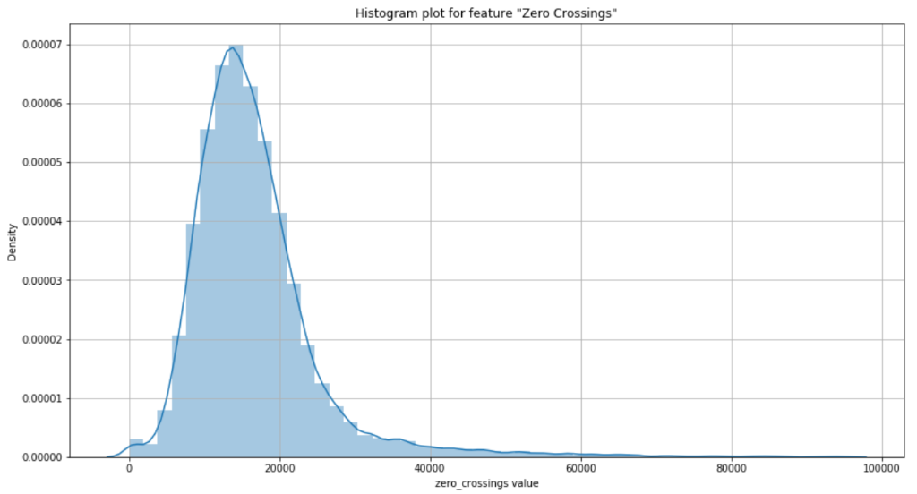
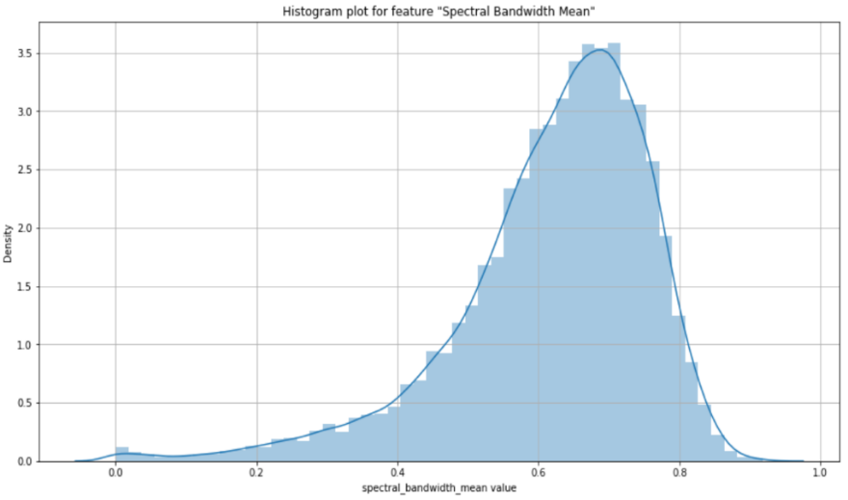
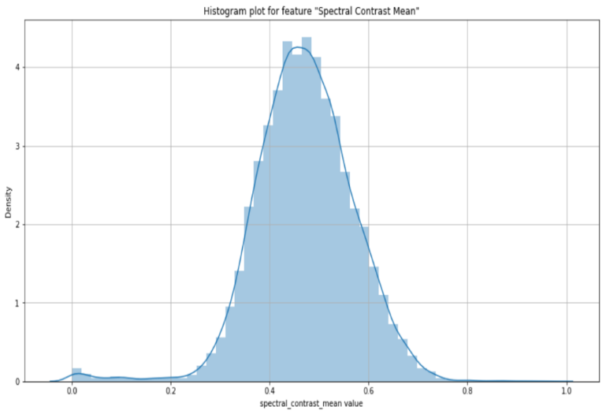
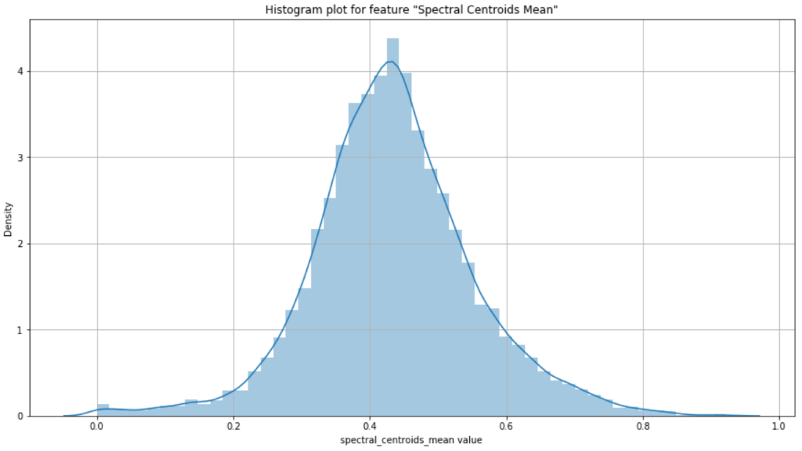
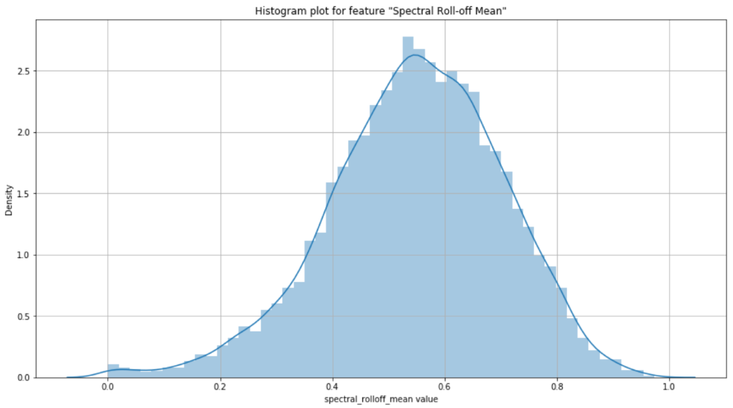
Univariate Analysis - Artists Data
Presented here a few samples of the Histogram Plots from a list of 124 features.

Slide 13
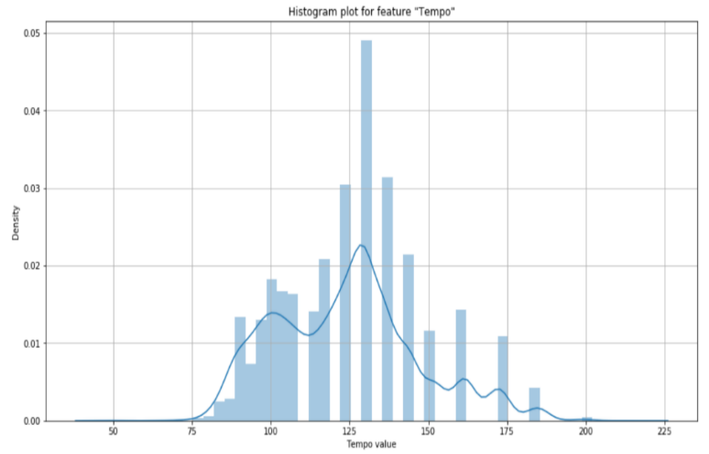
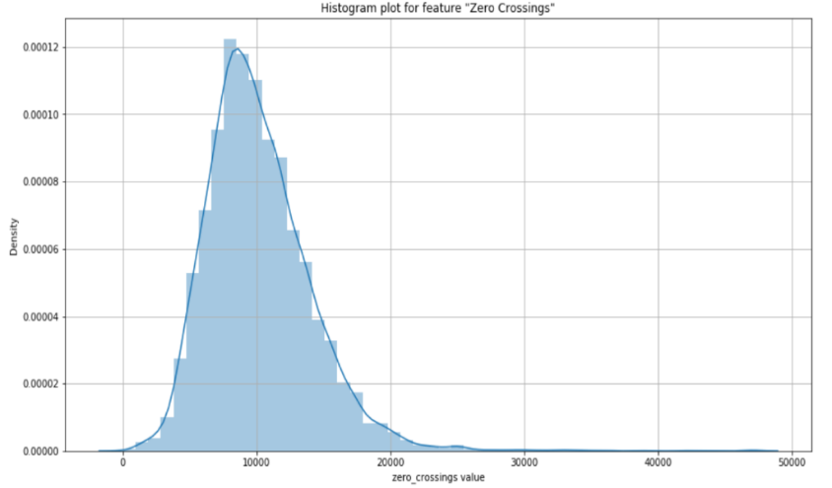
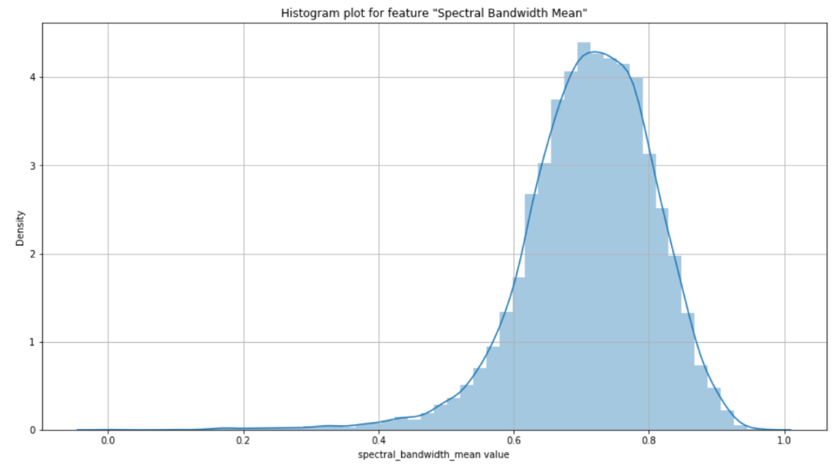
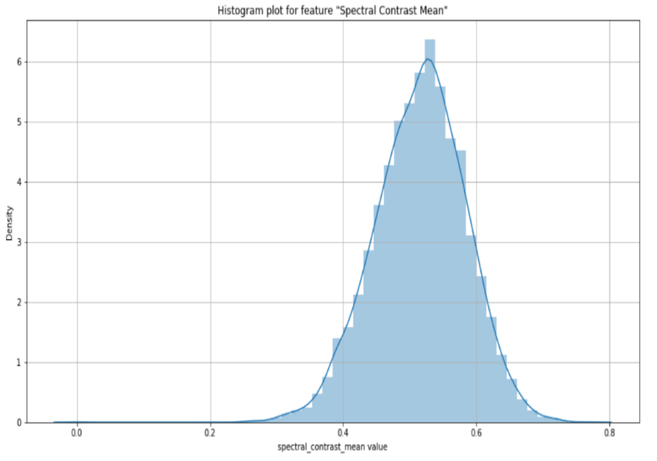
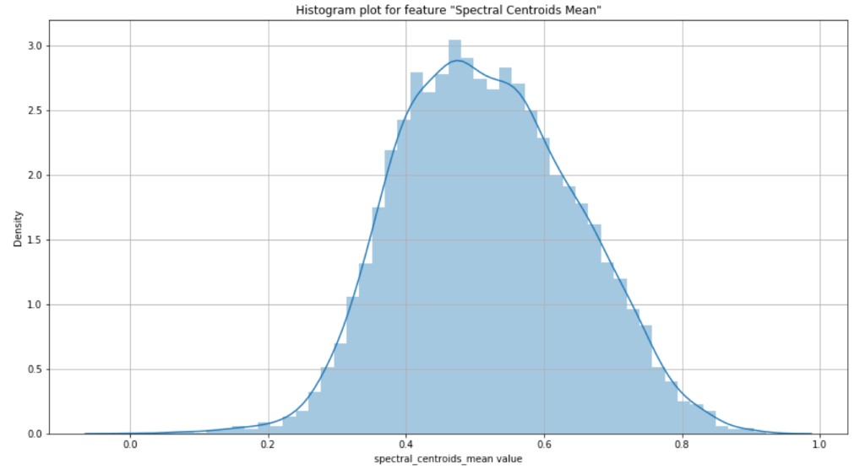
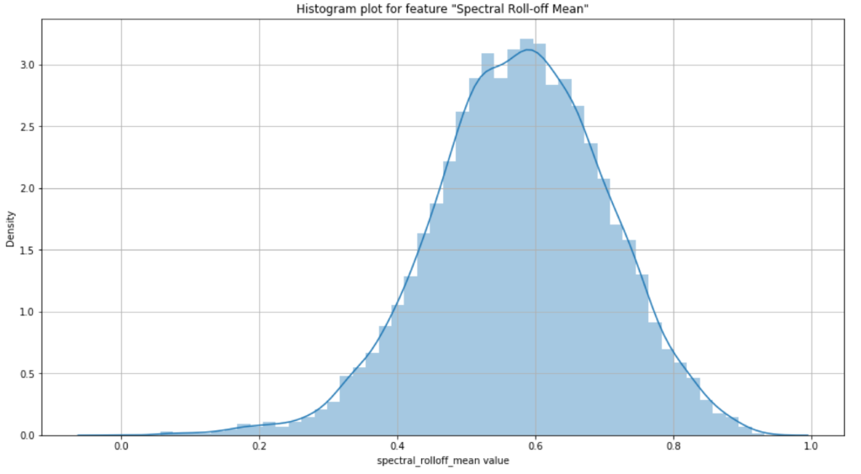
Univariate Analysis - Genre Data
Presented here a few samples of the Histogram Plots from a list of 124 features.

Slide 14
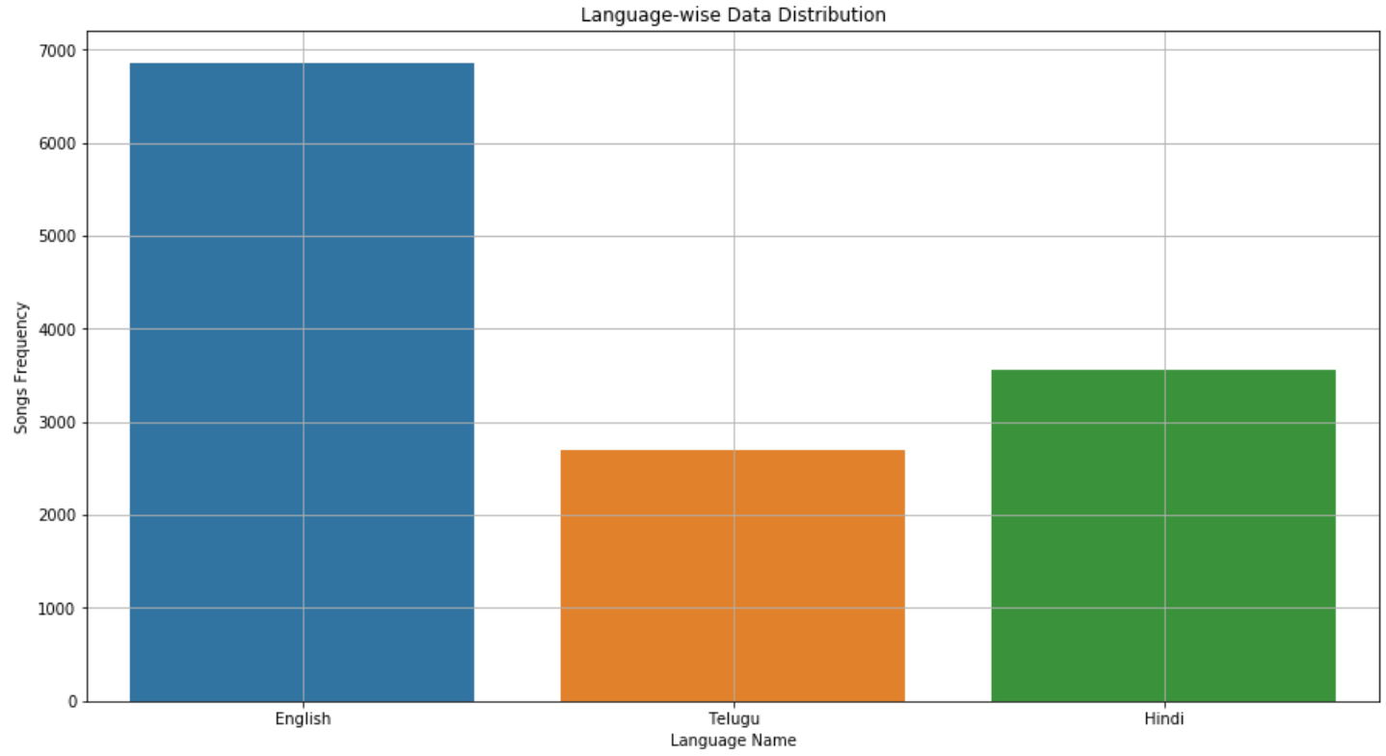
Language Distribution – Artist Data

Slide 15
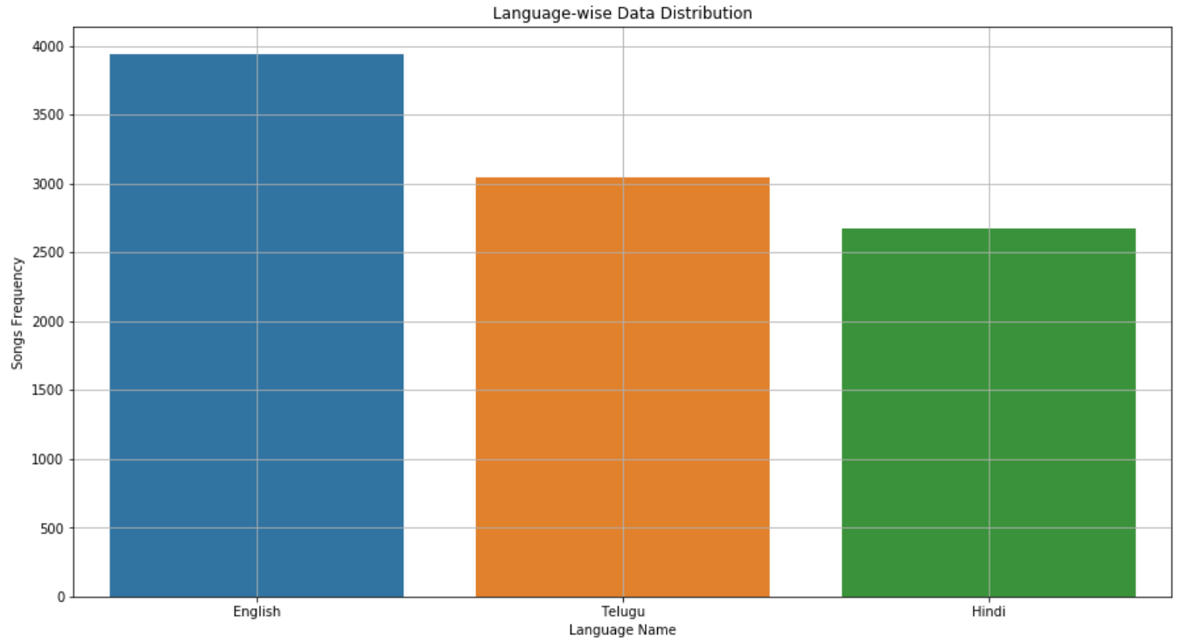
Language Distribution – Genre Data

Slide 16
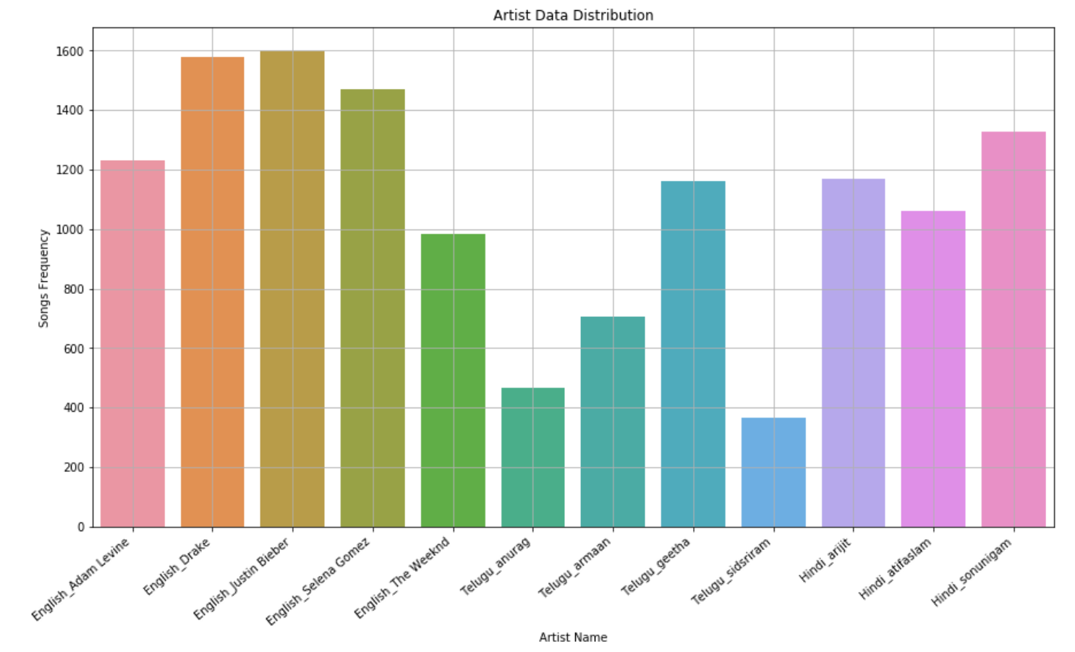
Target Variables - Artist Data

Slide 17
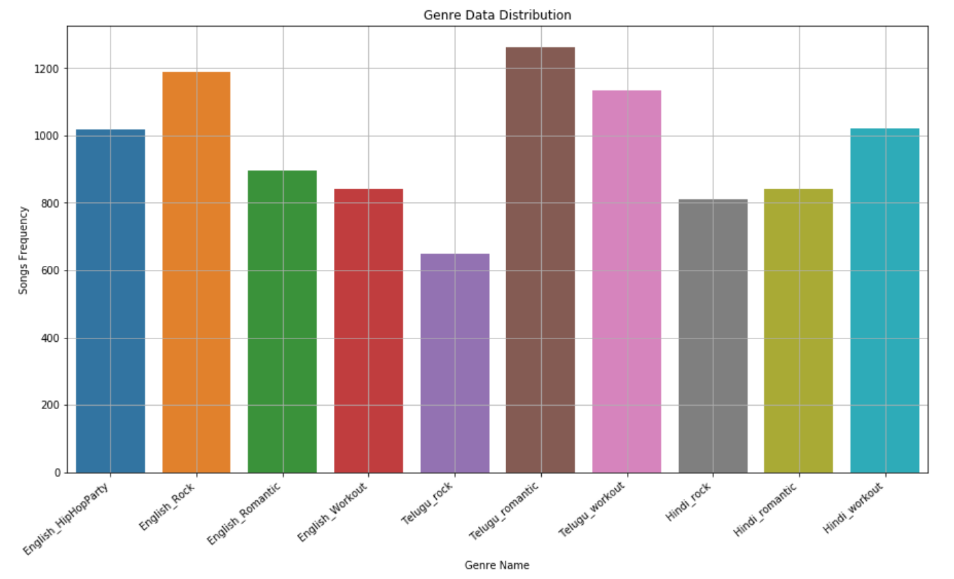
Target Variables - Genre Data

Slide 18
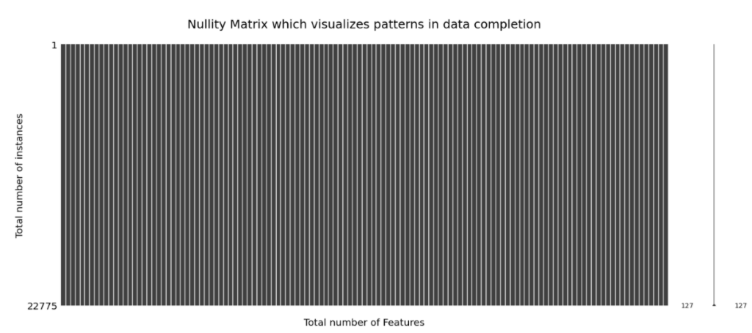
Missing Values
There are no missing values in the dataset.
Below image conveys the null data information from both data sets (Artists & Genre).

Slide 19

Outlier Analysis Methods
Z-score
Z-score tells how many standard deviations away a given observation is from the mean.
IsolationForest
The isolationForest is a sklearn-ensemble method which ‘isolates’ observations by randomly selecting a feature and then randomly selecting a split value between the maximum and minimum values of the selected feature.

Slide 20

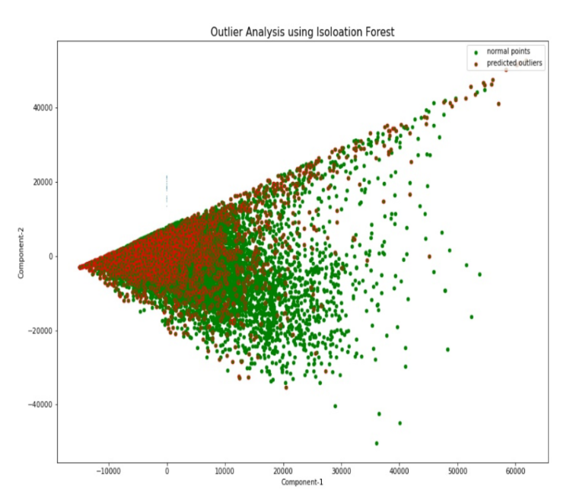
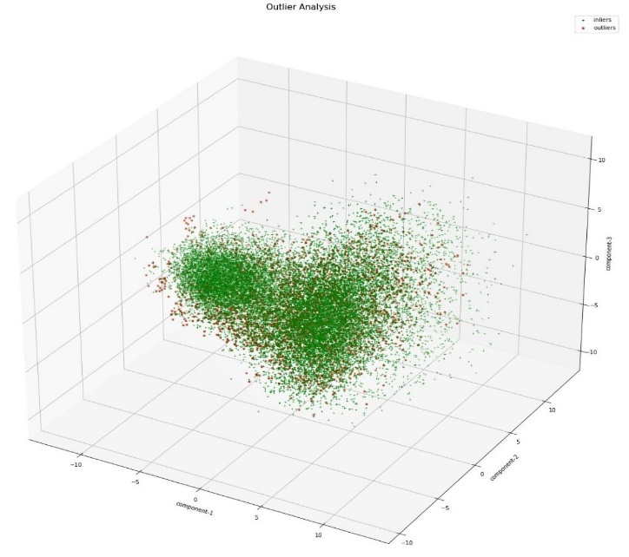
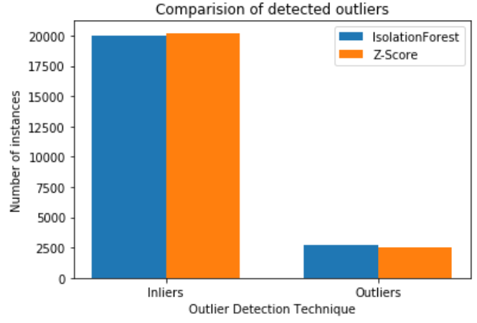
Outlier Analysis Artist Data
Artist data:
Using z-score, out of 13116 instances 1396 are detected to be outliers for the artist data.
Using isolationforest, 1574 outliers from 13116 instances are detected as outliers.
By observing the outliers, we concluded that isolationforest is better approach for our data

Slide 21
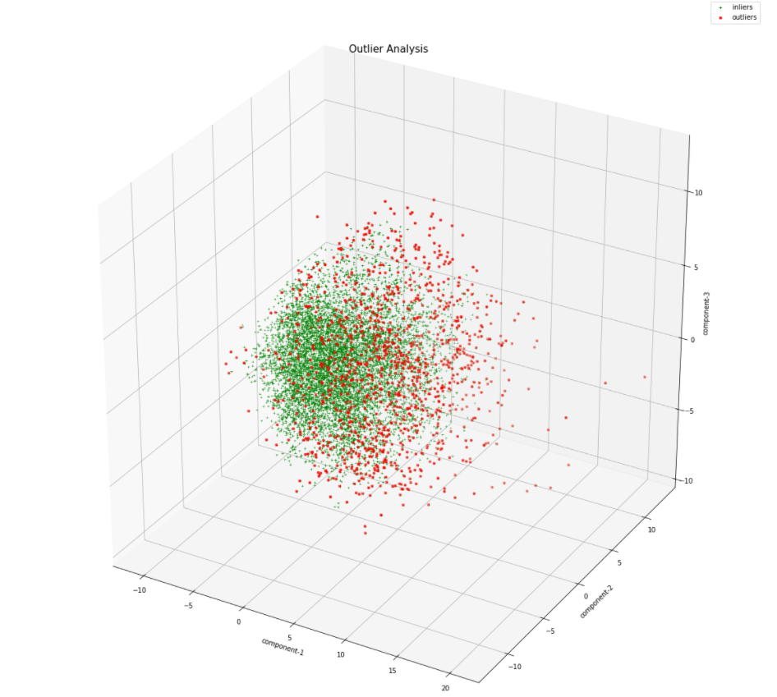
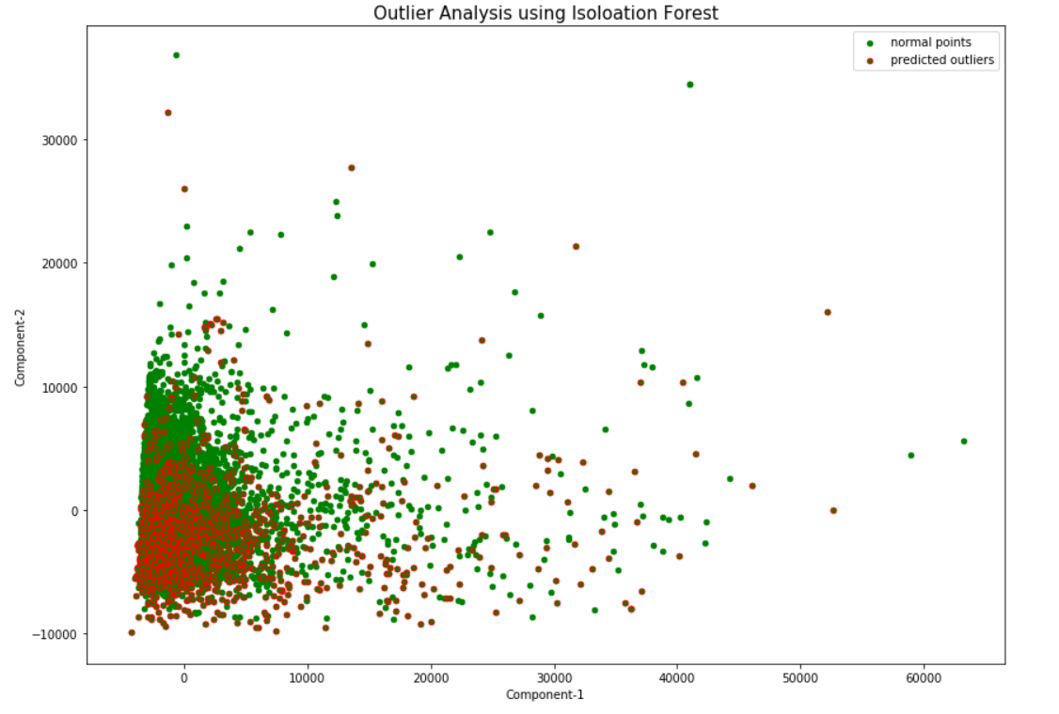
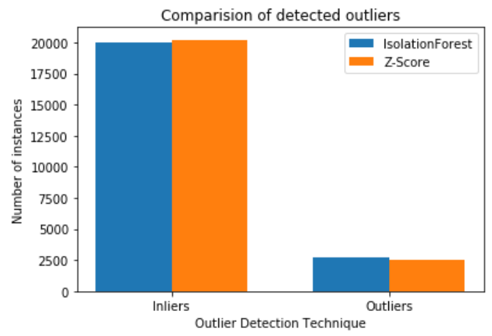
Outlier Analysis Genre Data
Genre Data
Using Z-score, out of 9659 instances 1154 are detected to be outliers for the artist data.
Using IsolationForest, 1159 outliers from 9659 instances are detected as outliers.
By observing the outliers, we concluded that IsolationForest is better approach for our data

Slide 22
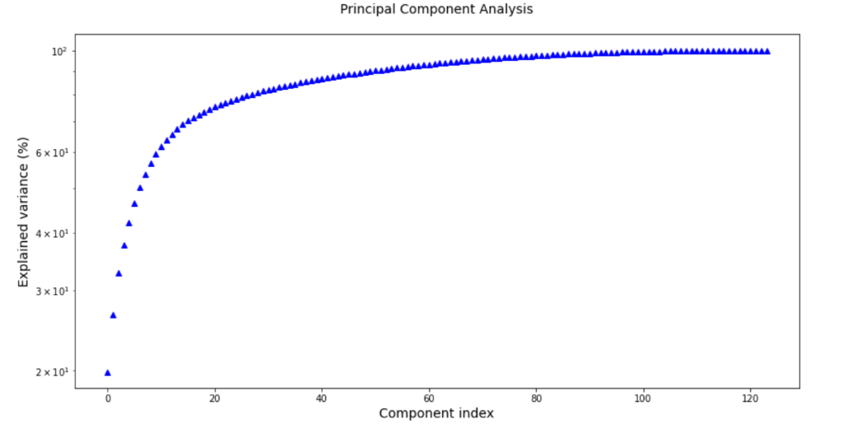
PCA - Artist Data
From the above graph, by considering 80 components we could preserve more than 96% of variance in the data.
By applying PCA we have reduced number of features from 124 to 80 without losing much variance in the Artist data.

Slide 23
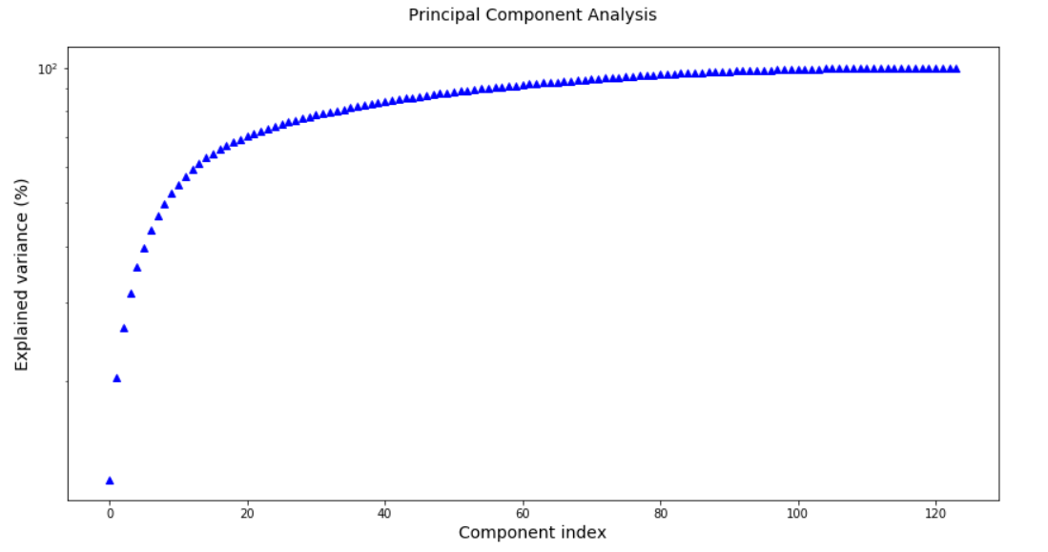
PCA - Genre Data
From the above graph, by considering 90 components we could preserve more than 96% of variance in the data.
By applying PCA we have reduced number of features from 124 to 90 without losing much variance in the Genre data.

Slide 24
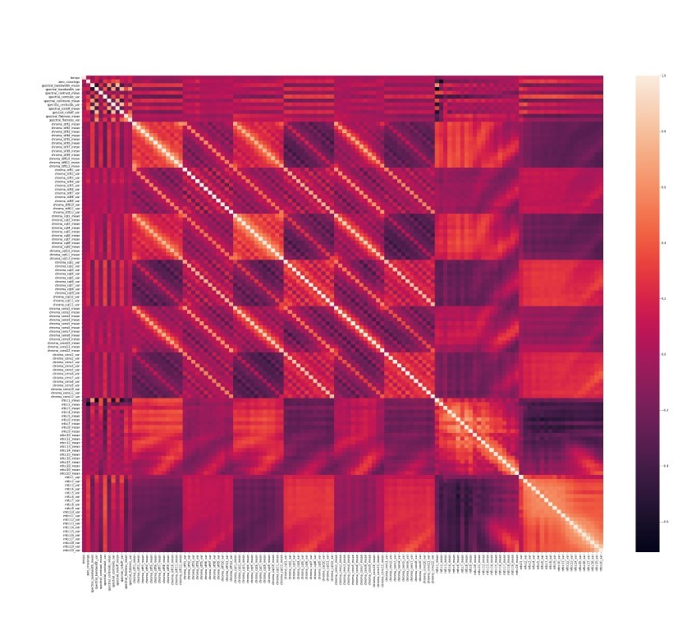
Heat Map (Artist Data)
Since heat-map is not clear in understanding the correlation between the features we have plotted pairwise plots for most positive and negative correlated attributes.

Slide 25
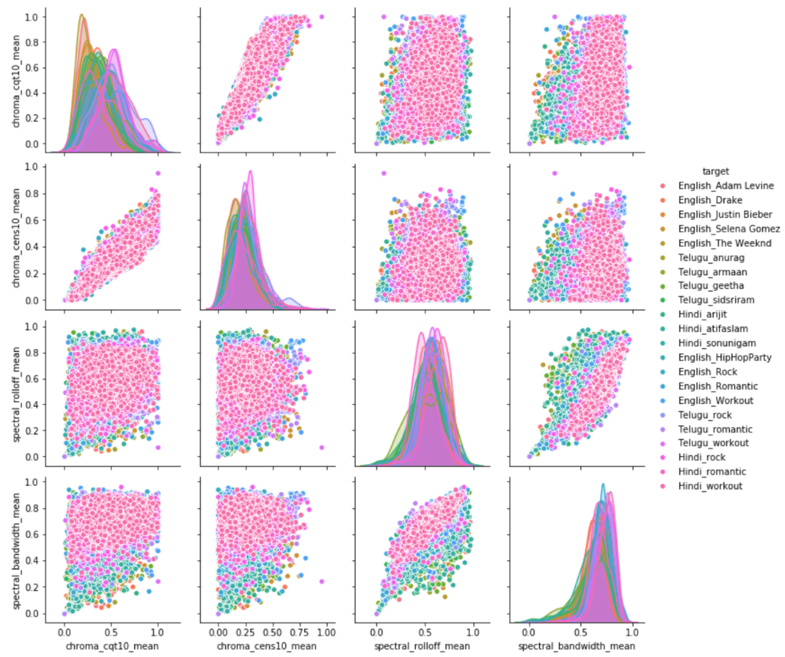
Pairwise Positive Correlation (Artist Data)
Positive correlation plot for attributes:
‘Chroma_cqt10_mean’
‘Chroma_cens10_mean’
‘Spectral_rolloff_mean’
‘Spectral_bandwidth_mean’

Slide 26
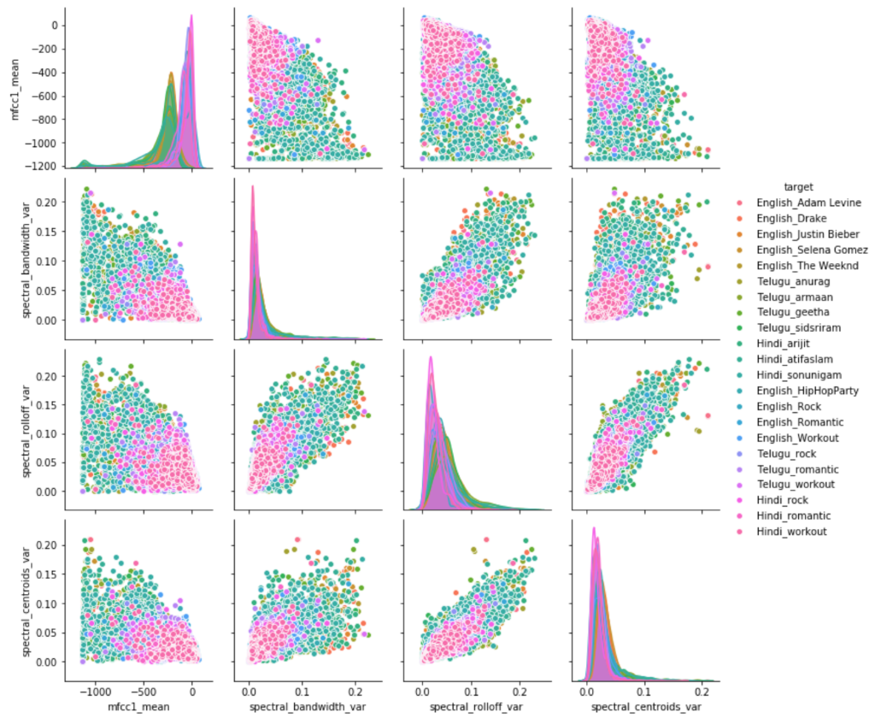
Pairwise Negative Correlation (Artist Data)
Negative correlation plot for attributes:
'mfcc1_mean’
'spectral_bandwidth_var’
'spectral_rolloff_var’
'spectral_centroids_var'

Slide 27
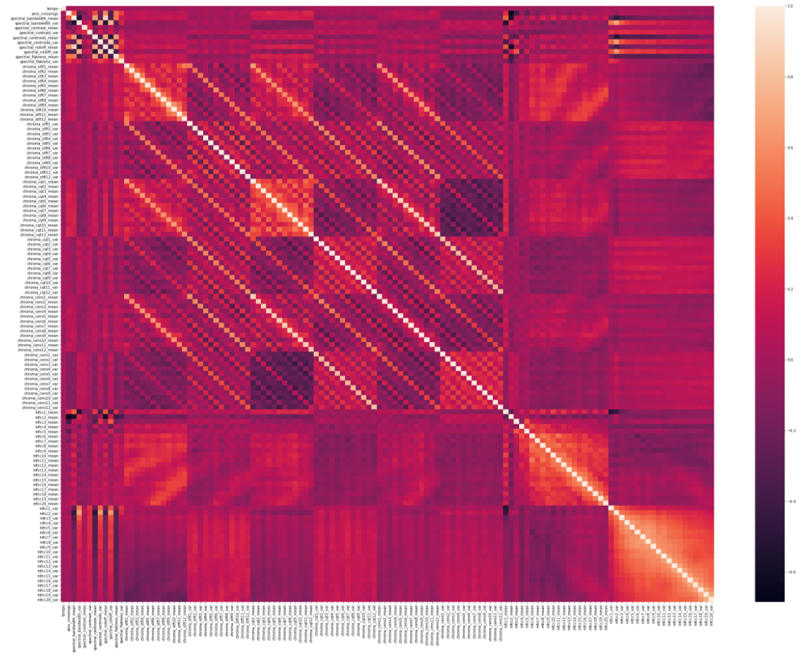
Heat Map (Genre Data)
Since heat-map is not clear in understanding the correlation between the features we have plotted pairwise plots for most positive and negative correlated attributes

Slide 28
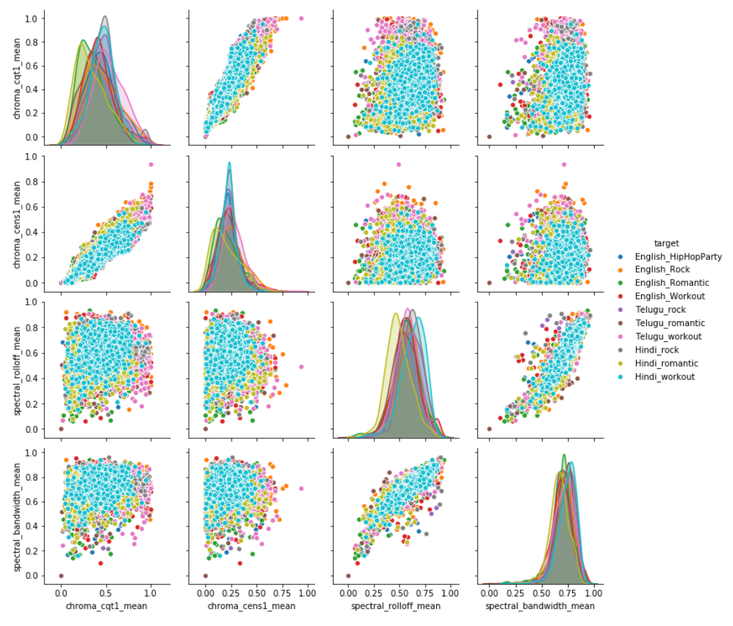
Pairwise Positive Correlation (Genre Data)
Positive correlation plot for attributes:
'chroma_cqt1_mean’
'chroma_cens1_mean’
'spectral_rolloff_mean’
'spectral_bandwidth_mean'

Slide 29
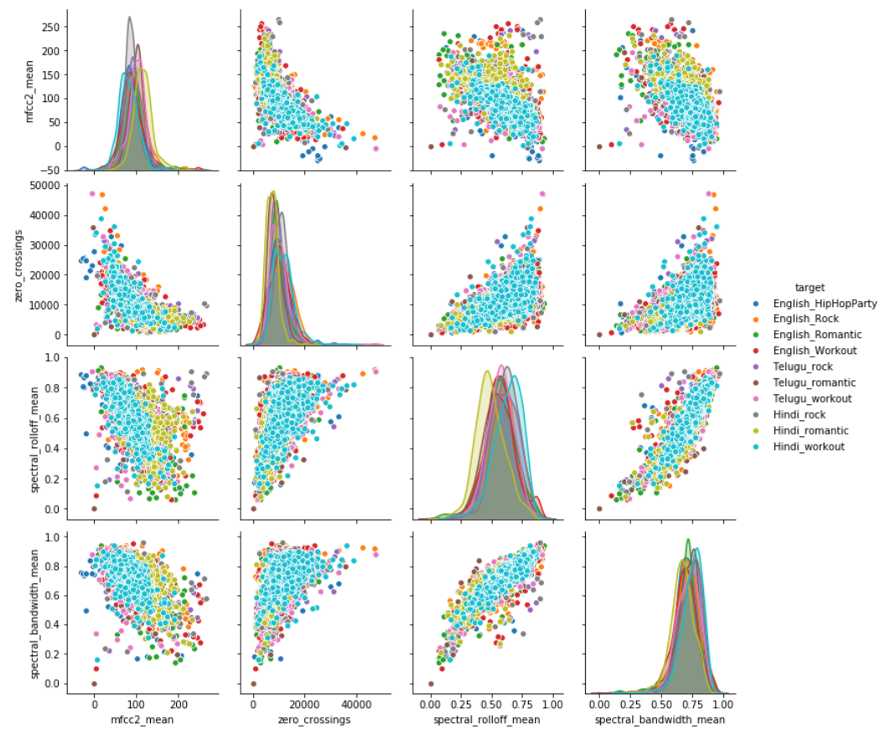
Pairwise Negative Correlation (Genre Data)
Negative correlation plot for attributes:
'mfcc2_mean’
'zero_crossings’
'spectral_rolloff_mean’
'spectral_bandwidth_mean'

Slide 30

Challenges Faced
Dataset was huge, so understanding the importance of all variables was difficult.
Outlier analysis tuned differently and produced various results, tuning to an optimal value was a challenge
Splitting and Extracting features from WAV file was time-consuming.
Issue while using Librosa.Load function - Sndfile.dll has no attribute error has been encountered. Had to change few lines of code in Librosa package to resolve.
Owing to huge space occupied by each instance of the song (5 second window), we couldn’t afford to save .wav file of each instance separately. Instead, used a single buffer storage for all instances and extracted the required features.

Slide 31

Future Work
To build separate models for Singer Identification and Genre Identification
Training of CNN Model
Testing of CNN Model
Hyper-Parameter Tuning
Metrics Evaluation
Building Speech to Text conversion
To incorporate above model into an end-to-end application. (If time permits)

Slide 32

Thank You!

